Slide 1
Customer Analysis

Slide 2
Abstract
Customer analysis is a crucial component of any business strategy, providing insights into consumer behavior, preferences, and trends. This abstract will delve into the significance of customer analysis, its methodologies, and its applications in shaping business decisions.
Understanding customers is the cornerstone of successful marketing, product development, and sales strategies. By analyzing demographic data, purchasing patterns, and psychographic traits, businesses can create targeted marketing campaigns tailored to specific customer segments. Moreover, customer analysis helps identify emerging trends and shifts in consumer preferences, enabling businesses to adapt proactively.
Various methodologies are employed in customer analysis, including surveys, interviews, focus groups, and data mining techniques. Advanced analytics tools allow businesses to gather and analyze large volumes of data efficiently, uncovering valuable insights that drive informed decision-making.
The applications of customer analysis span across industries, from retail and e-commerce to hospitality and finance. By gaining a deeper understanding of their target audience, businesses can enhance customer satisfaction, foster brand loyalty, and ultimately drive revenue growth.
In conclusion, customer analysis is an indispensable tool for businesses seeking to gain a competitive edge in today's dynamic marketplace. By leveraging data-driven insights, businesses can anticipate customer needs, refine their offerings, and build lasting relationships with their target audience.

Slide 3
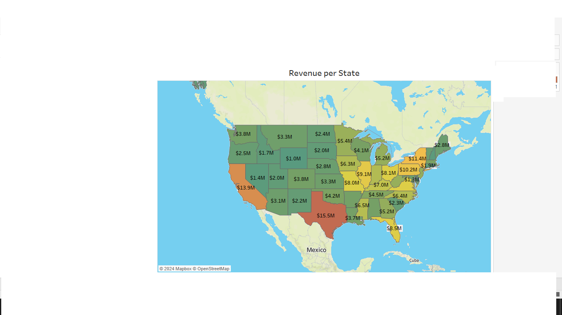
Revenue per State

Slide 4
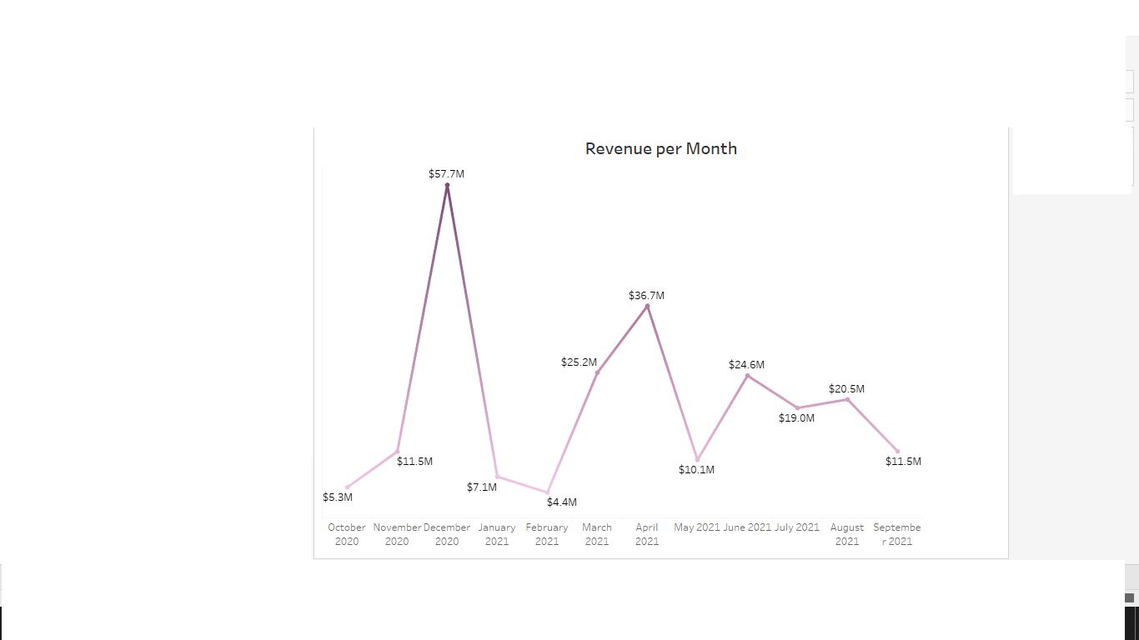
Revenue per month

Slide 5
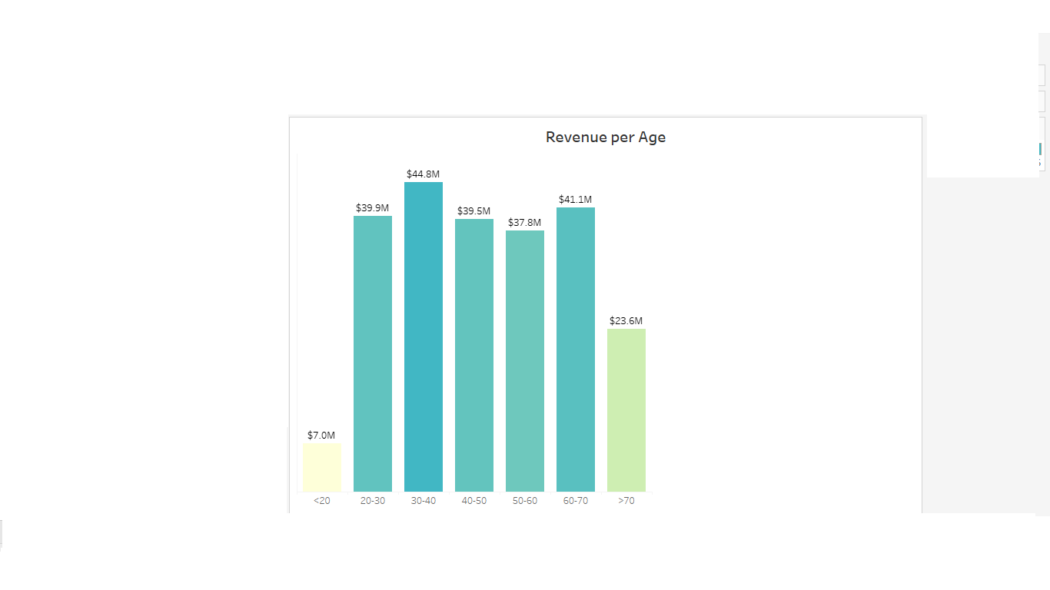
Revenue per age

Slide 6
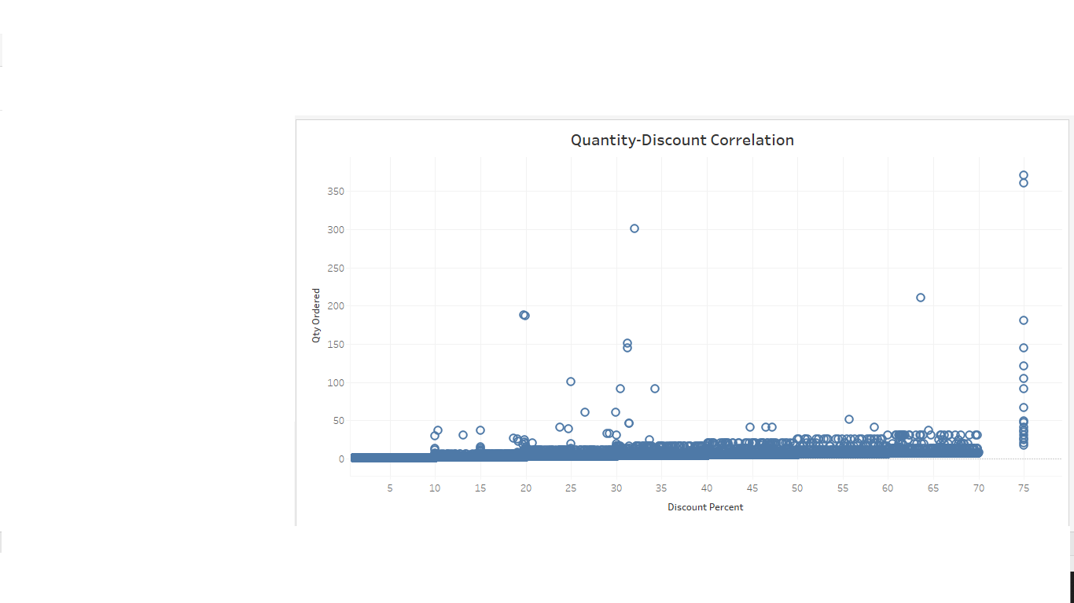
Quantity-Discount correlation

Slide 7
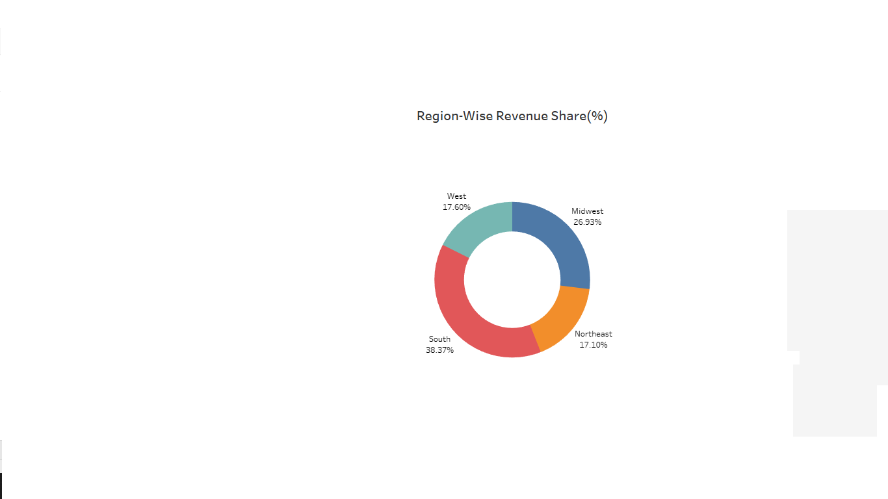
Region-wise Revenue share

Slide 8
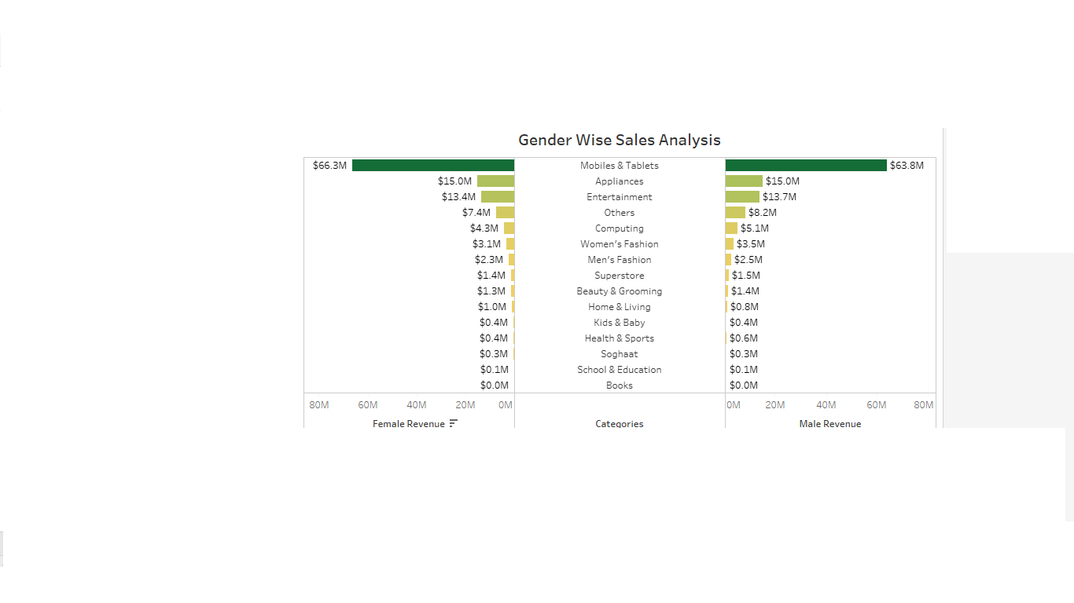
Gender wise Sales Analysis

Slide 9
